Slide 1
Graph Theory
Graph Coloring and its application

Slide 2
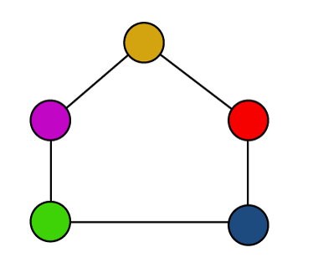
Graph coloring
Graph coloring can be described as a process
of assigning colors to the vertices of a graph.
In this, the same color should not be used to
fill the two adjacent vertices.
We can also call graph coloring
as Vertex Coloring.

Slide 3
Chromatic Number
The chromatic number can be described as the minimum number of colors required to properly color any graph.
In other words, the chromatic number can be described as a minimum number of colors that are needed to color any graph in such a way that no two adjacent vertices of a graph will be assigned the same color.

Slide 4
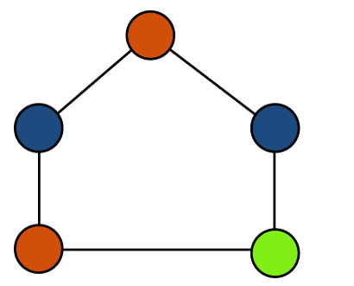
Example of Chromatic number
The given graph contains some points, which are described as follows:
The same color is not used to color the two adjacent vertices.
The minimum number of colors of this graph is 3, which is needed to properly color the vertices.
Hence, in this graph, the chromatic number = 3

Slide 5
Graph Coloring Algorithm-
Greedy Algorithm-
Step-01:
Color first vertex with the first color.
Step-02:
Now, consider the remaining (V-1) vertices one by one and do the following-
Color the currently picked vertex with the lowest numbered color if it has not been used to color any of its adjacent vertices.
If it has been used, then choose the next least numbered color.
If all the previously used colors have been used, then assign a new color to the currently picked vertex.

Slide 6
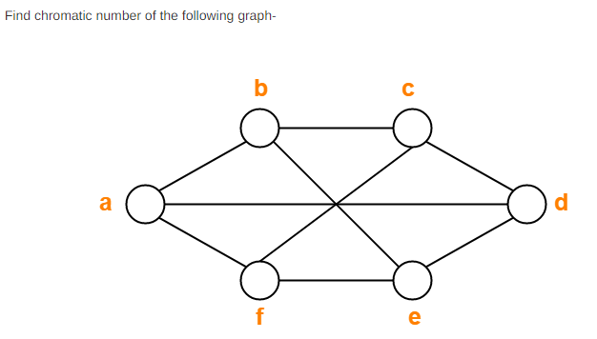
Problem-01

Slide 7
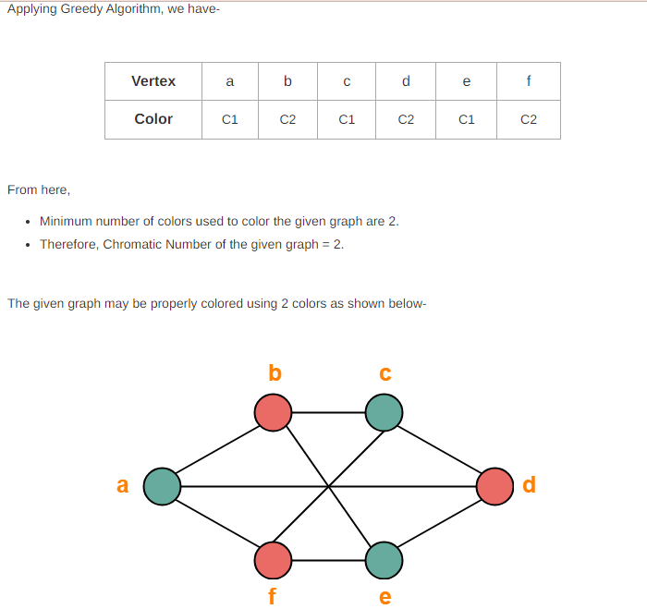

Slide 8
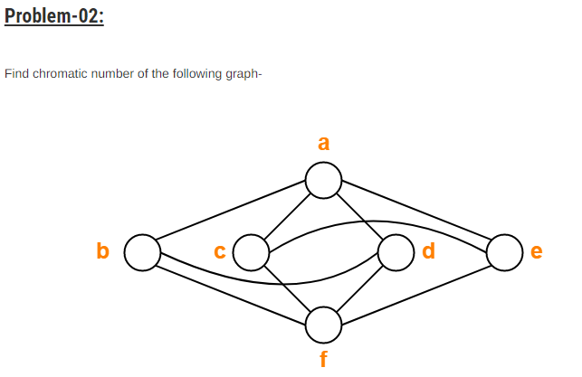

Slide 9
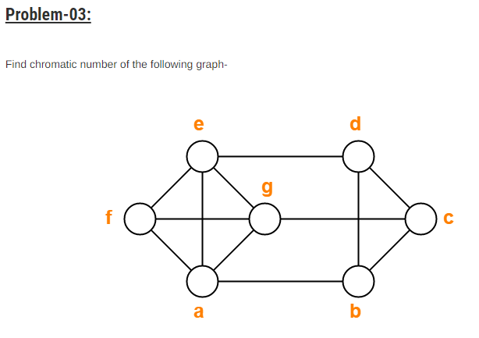

Slide 10
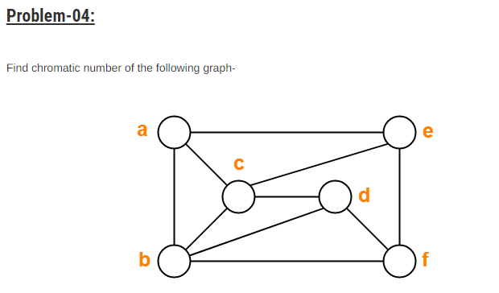

Slide 11
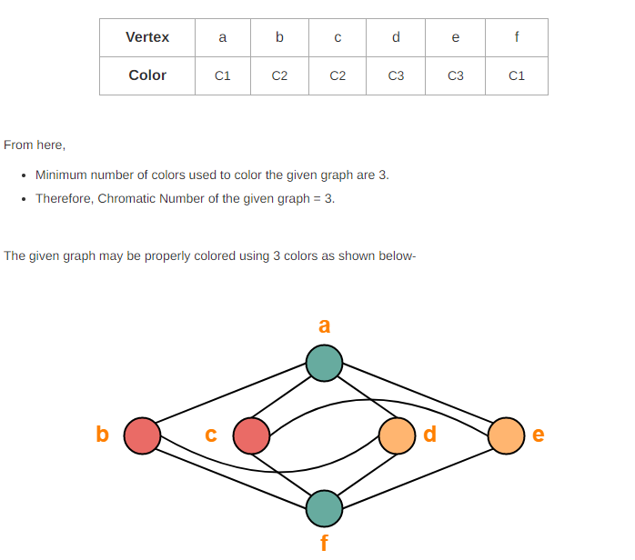
Solution-(problem-02)

Slide 12
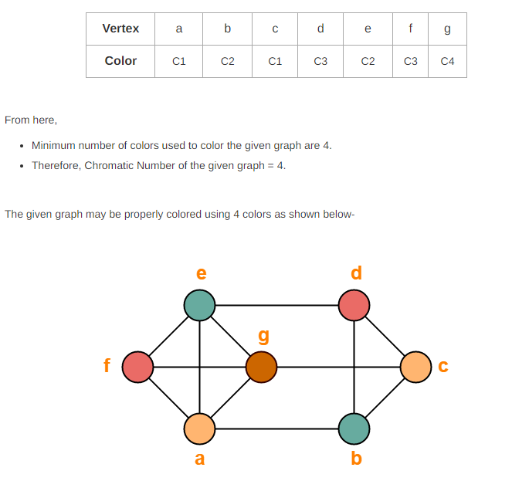
Solution-(problem-03)

Slide 13
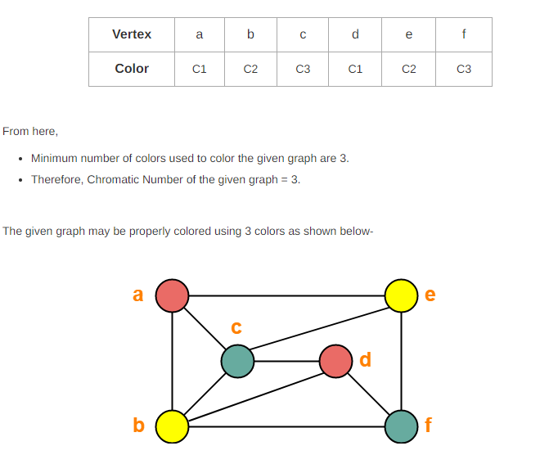
Solution-(problem-04)

Slide 14
Applications of Graph coloring
There are various applications of graph coloring. Some of their important applications are described as follows:
Assignment
Map coloring
Scheduling the tasks
Prepare time table

Slide 15
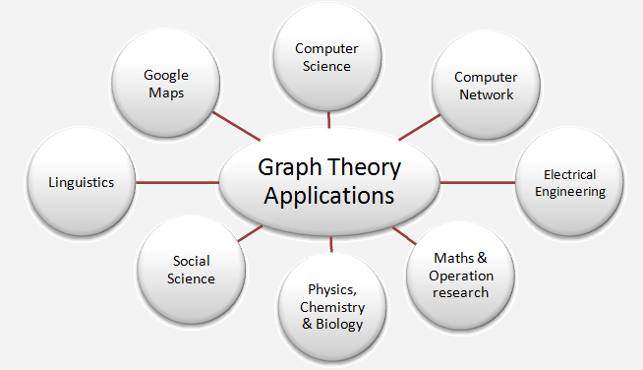
Application of graph theory

